Slide 1


SoC FPGA implementation of
Hopfield Neural Network
for solving the
Shortest Path Problem
Agustin Silva

Slide 2
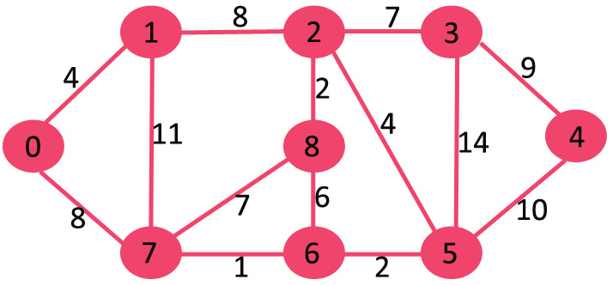

Trieste - Italy

Slide 3
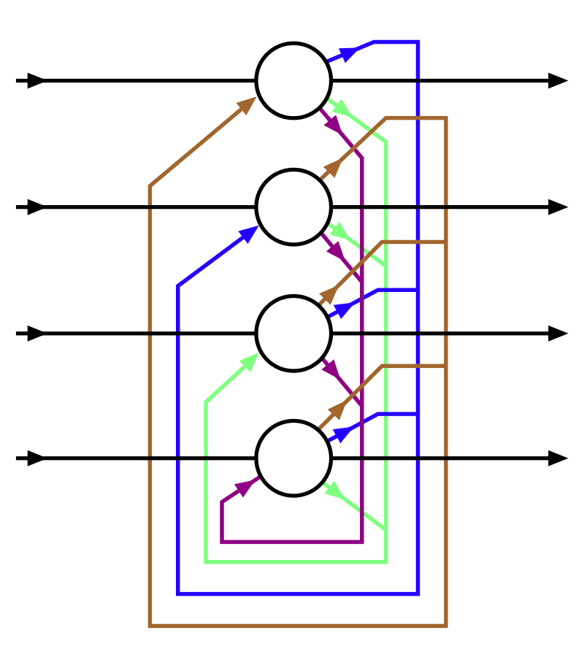

Trieste - Italy

Slide 4
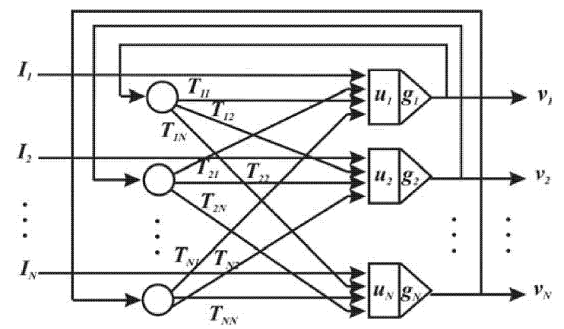
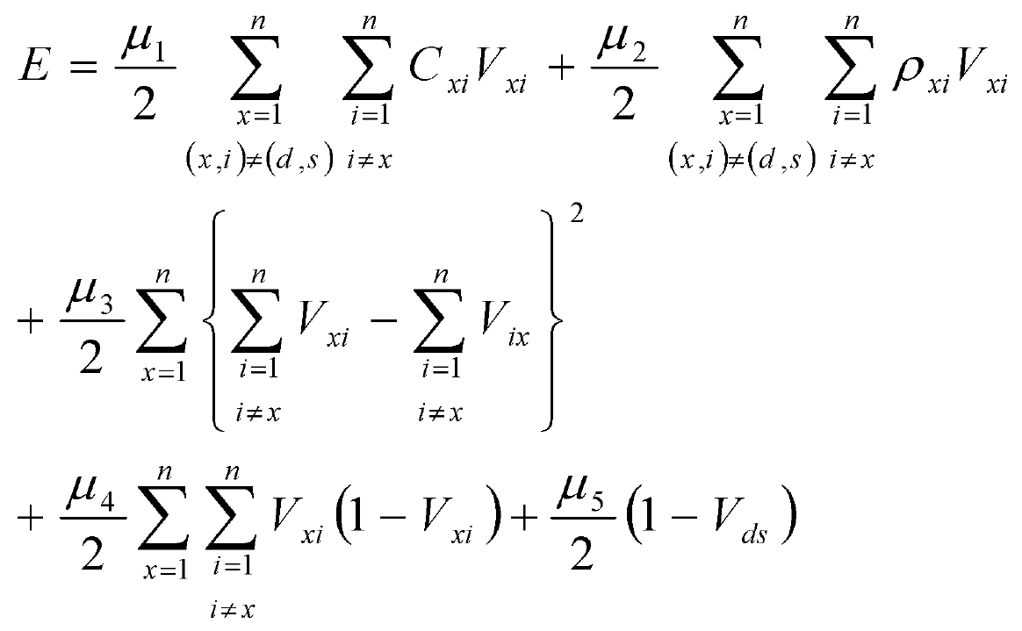
Trieste - Italy

Slide 5
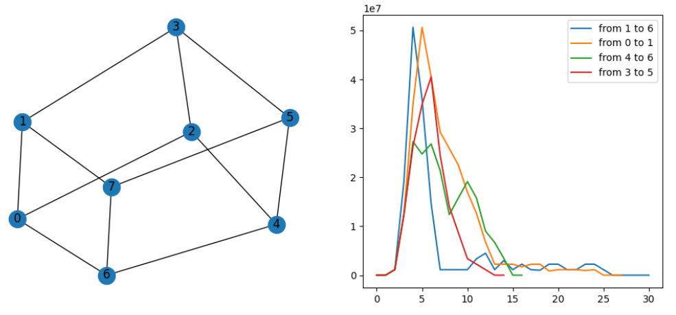
Trieste - Italy

Slide 6
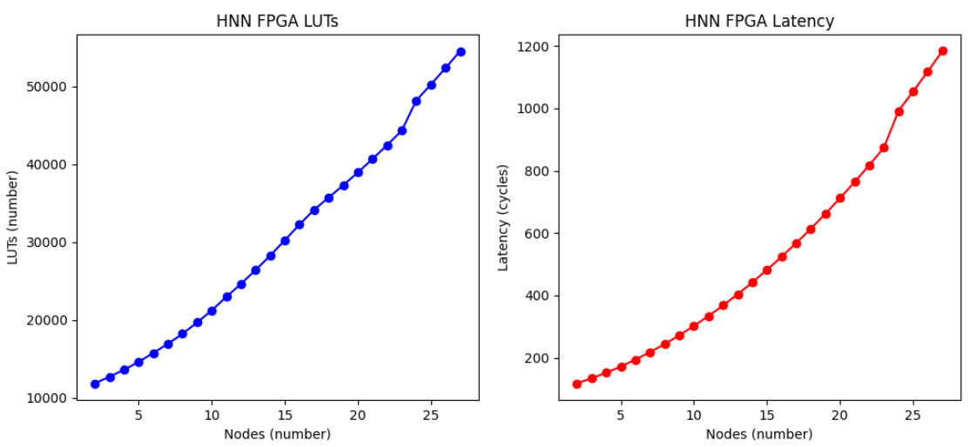

Trieste - Italy

